Slide 1
Organic Redox (Flow) Battery
Nikolas Vitaliti s223455

Slide 2
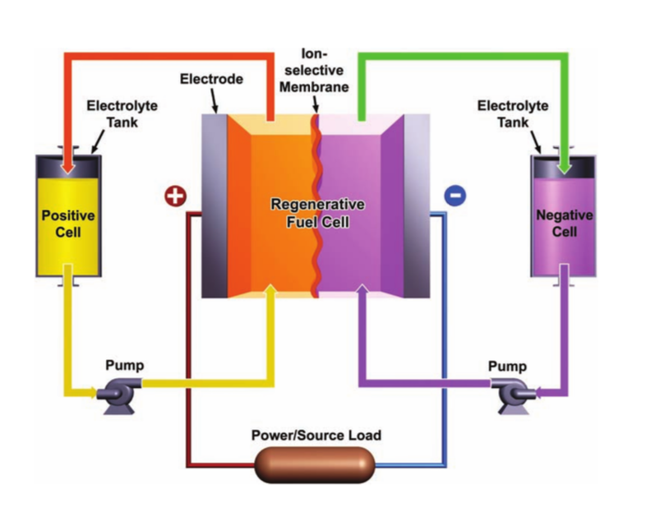
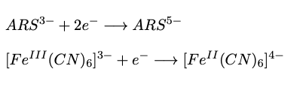
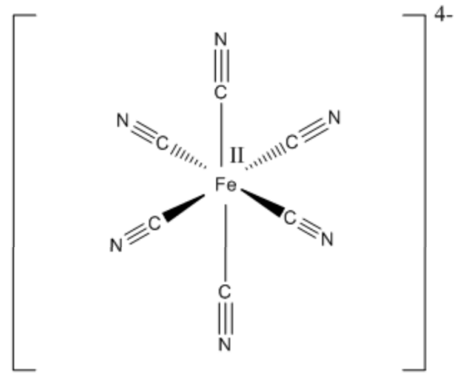
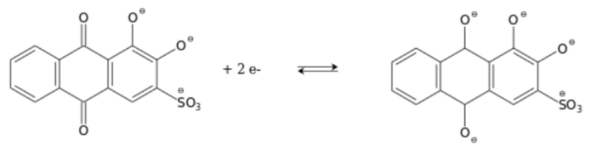
Introduction
Investigate the properties of an organic redox (flow) battery
Ferrocyanide as posolyte and ARS as negolyte
Electrode reactions:
Ferrocyanide
ARS (Alzarine Red s)
Notes:
ARS: two-electrode response

Slide 3
Flow chart
Methodology
Cyclic Voltammetry
Charge - Discharge
SOC
Volumetric capacity
Volumetric energy density
Cell potential
Electrolytes
Battery

Slide 4
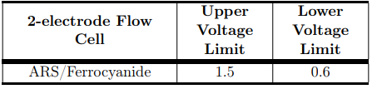
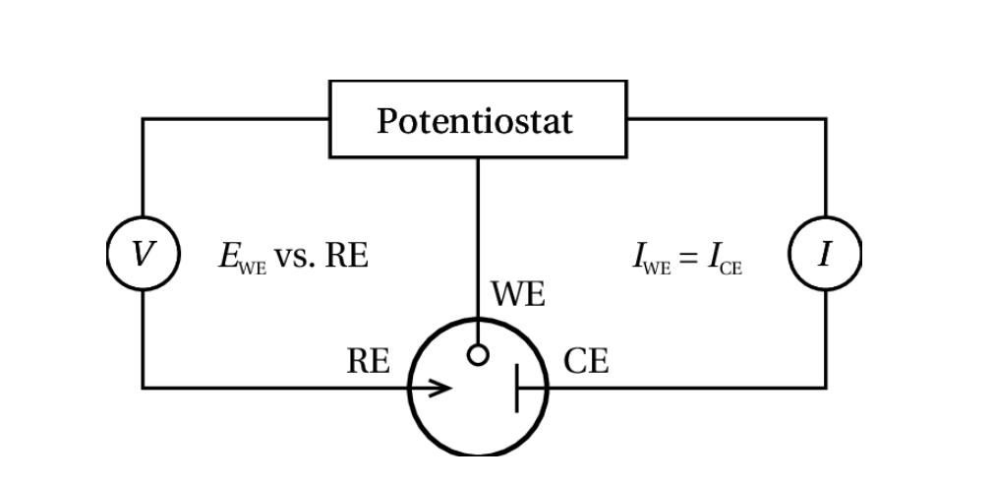
Experimental setup
CYCLIC VOLTAMMETRY
Three electrode setup
Aqueous solution of 1 M KOH:
2 mM Ferrocyanide​
2 mM Alzarine Red s (ARS)
CHARGE-DISCHARGE EXPERIMENT
Aqueous solution of 1 M KOH :
Posolyte: 1.8 mL of 0.2 M Ferrocyanide​
Negolyte: 2.3 mL of 0.05 M ARS
WE: Glassy carbon disk coated in a chemically resistant polymer
CE: Coiled platinum wire
RE: Ag/AgCl

Slide 5
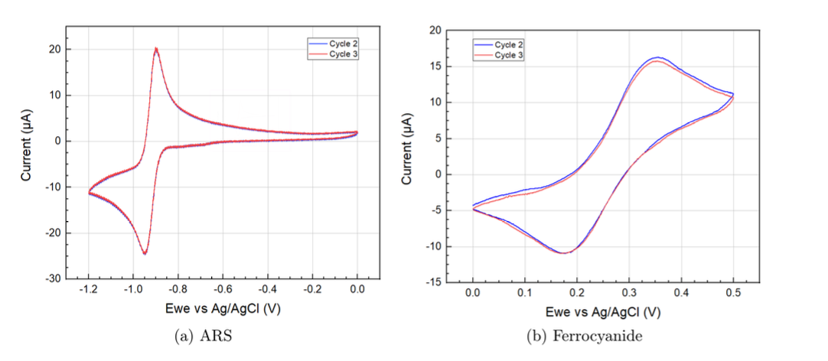


Cyclic Voltammetry
 | ARS | Ferrocyanide
E_{pa} | -0.9 V | 0.35 V
E_{pc} | -0.94 V | 0.17 V
scan rate: 50 mV/s
Investigate redox potential
Assumption: equal diffusion (i.e. capacity-balanced cell)
E^{0'}_{pos} = 0.26 V E^{0'}_{neg} = - 0.92 V

Slide 6
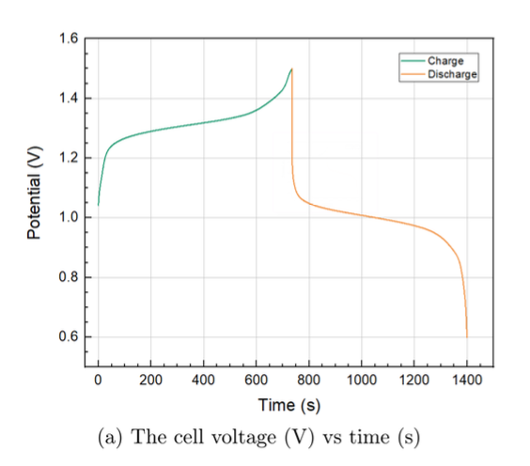
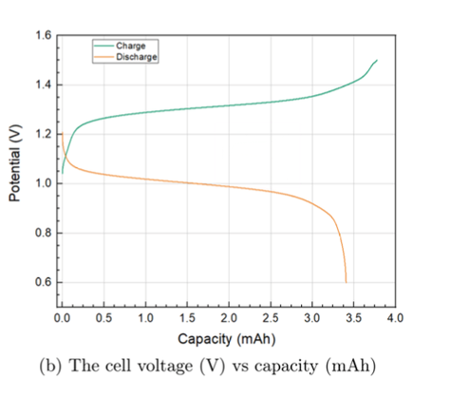

Charge-Discharge
Full cycle took 23.3 min
Loss of capacity

Slide 7
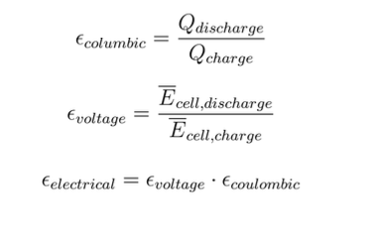




Charge-Discharge
Relatively good!
Increasing time i.e. lower C-rate:
Expect stationary CE and increased VE
However, a open-to-atmosphere-cell leads to side reactions
Notes:
CE= how much charge is in the battery versus how much charge do we actually put in
VE= Voltage efficiency measures the effects of cell polarisation or cell voltage losses.
EE= energy output with respect to our input

Slide 8
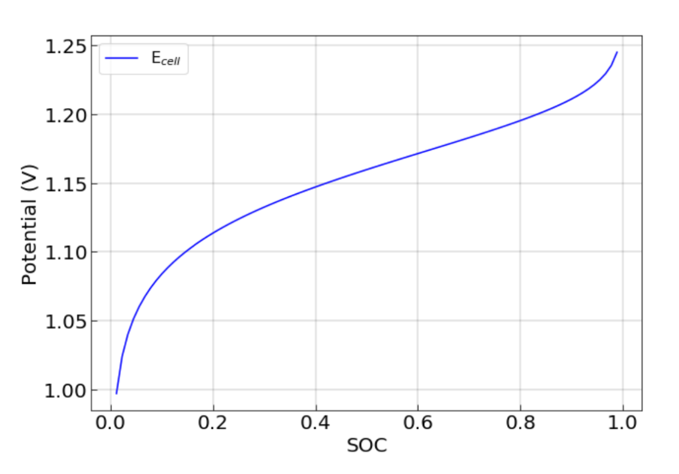
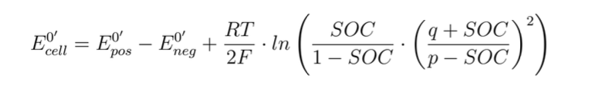



State of Charge
Theoretical overall cell potential as function of SOC:
Using the redox potential values :
This should be compared to the experimental SOC for charge and discharge:
*
E^{0'}_{pos} = 0.26 V
E^{0'}_{neg} = - 0.92 V
$$SOC=\frac{Q_{measured}}{Q_{max}}$$
*p and q being initial molarities of oxidized and reduced posolyte (i.e. limiting agent)

Slide 9
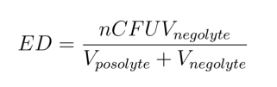
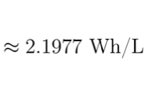



Volumetric Energy Density
Experimental battery
Capacity-balanced battery
Volumetric capacity of the investigated flow batttery
Energy density of investigated battery
Energy density of a capacity-balanced battery
Same effective concentration
Maximum solubility of ARS in 1 M KOH is 0.55 M (earlier 0.05 M)
Same cell potential as the experimental battery
$$Q_{ARS}=2.68 Ah/L$$
Q$=nCVF$
${ Q}_{Ferrocyanide}=5.36 Ah/L$

Slide 10
Conclusions
Redox potentials estimate to be 0.26 V for Ferrocyanide and –0.92 V for ARS
Overall good efficiencies: CE= 91.9% , VE= 80.3% , EE= 73.8%
Slower C-rates generally increase VE and therefore ultimately increase EE
Polarization leads to high losses in the charging-discharging process
Assuming a capacity balanced battery greatly increases energy density
Even by using the maximum solubility of ARS in 1M of KOH the energy density is still low
Notes:
Using the maximum solubility of ARS

Slide 11
Thank you!

